Slide 1

Cloud Driven IoT based Big Data Solution: Air Quality Monitoring System and Predictive Analysis of Satellite Data using Machine Learning
Course ID : CSE498
Section : 01
Project Supervisor : Dr. Mahady Hasan
Project executed by : Noureen Islam (1611077)
Noor-E Sadman (1730008)

Slide 2
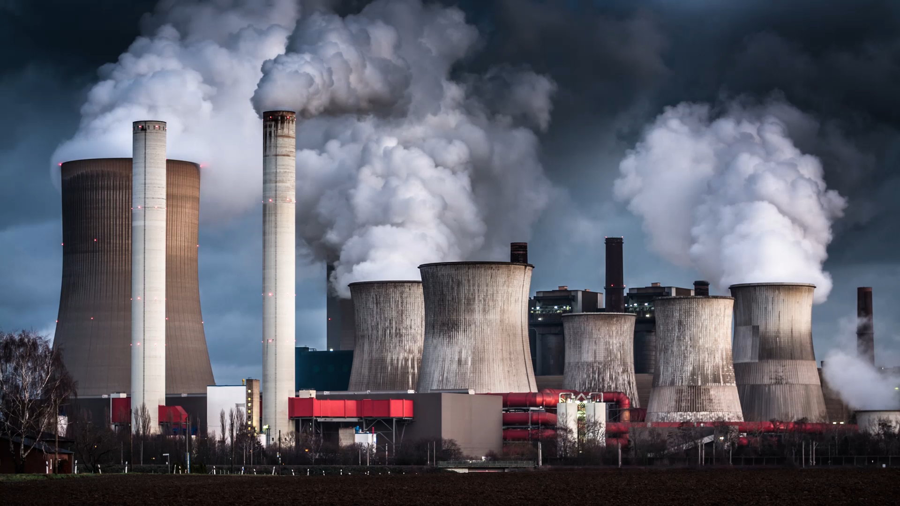
Air Pollution
Worldwide Crisis
Limited Solutions
Caused by the presence of toxic compounds in the atmosphere.
Harms the wellness of habitants
Hazardous to the ecosystem or objects.

Slide 3
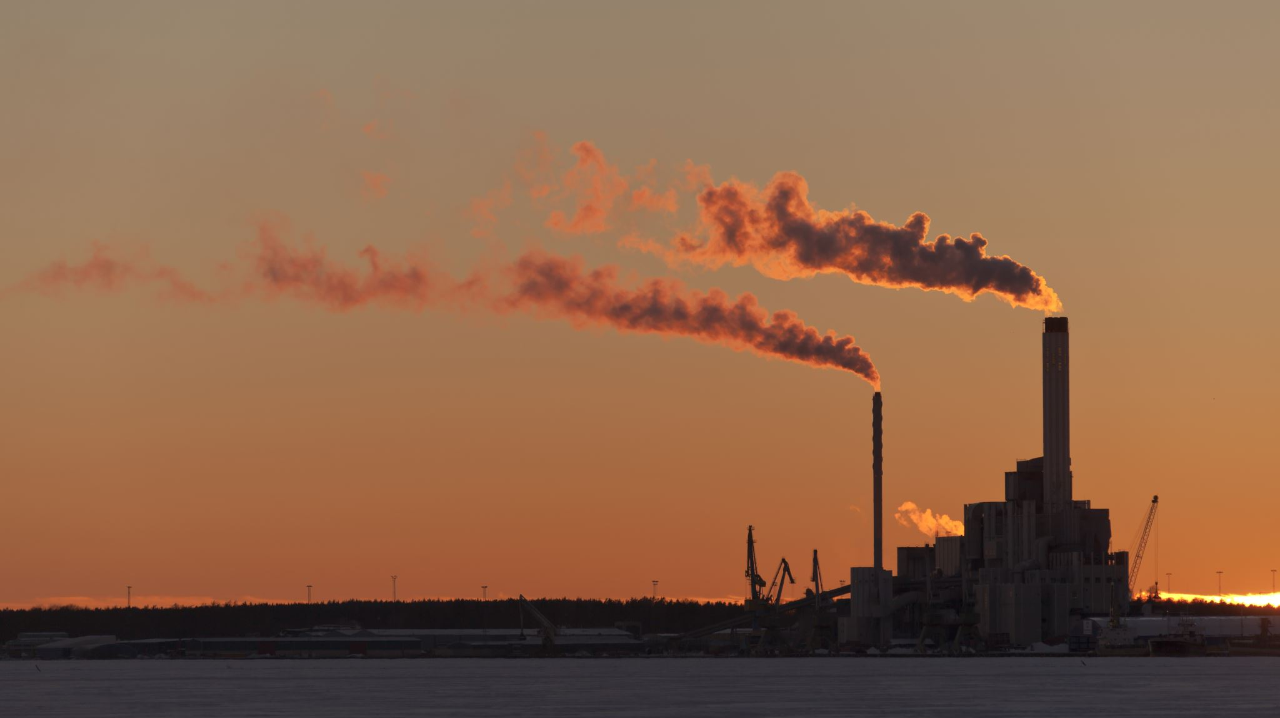
Effects of Air Pollution on Habitats and Environment
Respiratory Infection
Irritation to the nose, throat, eyes, or skin.
Global Warming
Degradation of architecture
Headaches, dizziness, and nausea
Heart and Lung Disease
Change in Soil Patterns

Slide 4
Statistics
Kills an estimated 7 million of the worldwide population.
4.2 million deaths every year due to outdoor air pollution.
3.8 million deaths due to indoor air pollutants.
99% of the population breathe contaminated air.
91% inhabitants resides in unlivable neighborhood.

Slide 5

Cause of Air Pollution
Gaseous contaminants formed by industrial areas and transportation
Incomplete combustion and heavy metal infiltrating water and food supply causing Persistent Organic pollutants.
Power plants, automobiles and industries are the prime source for the emission of Particulate Matter.

Slide 6

Project
To introduce an inexpensive solution to the problem.
To reach our solutions from rural to urban areas.
To diminish the ‘Air Pollution’ called worldwide crisis.
Help people monitor the air quality around the country.
Goals
To make a device as identical to the expensive air quality industrial device.
Improve air quality around the world.

Slide 7

Project Scope
Propositions to overcome this worldwide crisis :
1.
Air Quality Monitoring System (CAQ)
2.
RefinAir (An IoT based Approach)
3.
Prediction of PM2.5 (Machine Learning Approach)
(A Big Data Driven Software Approach)

Slide 8

A hypothetical approach
Air Quality Monitoring System (CAQ)
Software Implementation
Generate Atmospheric Map
Generate an Atmospheric Forecast System
Generate Industrial Area Monitoring Map
Generate Area-wise AQI Map
Generate Transportation Route AQI Map
Generate Charts

Slide 9
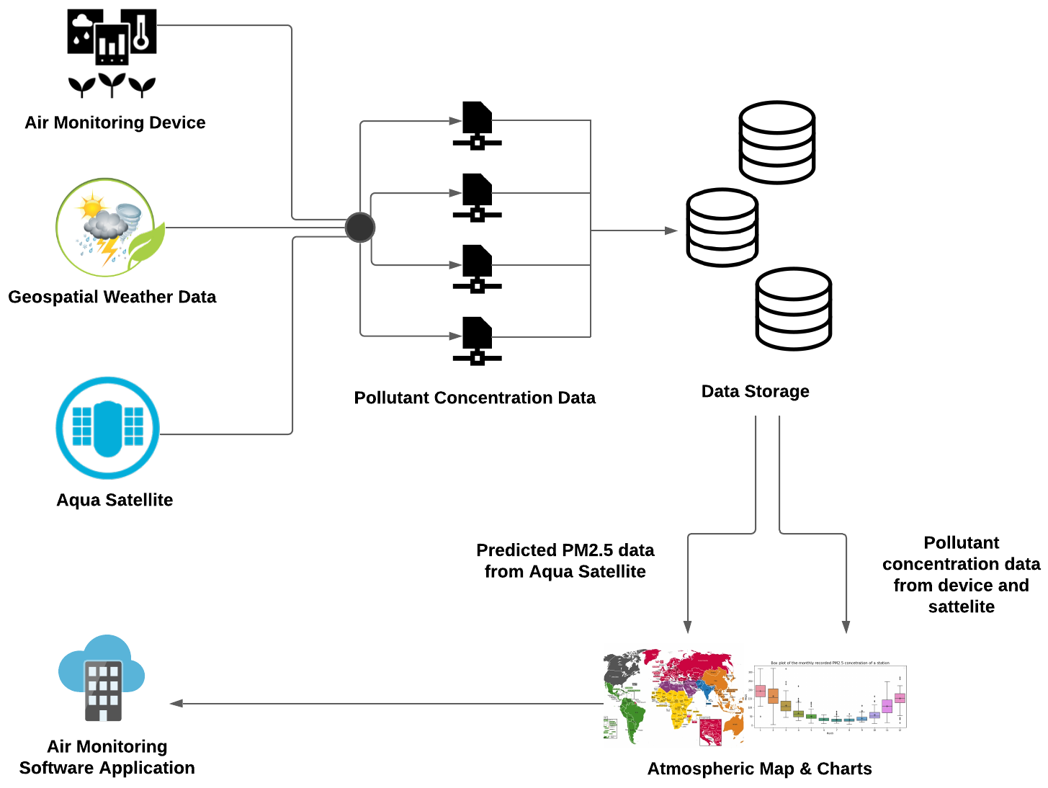
Rich Picture of CAQ

Slide 10
Proposed System for Air Monitoring System
Sensors are mounted on transportations as node.
Sensors take multiple data of the routes.
Communication sensor sends data to website with location and time stamp.
Whenever the device detects wifi, the wide range of data is uploaded to a server.
After the data being uploaded to the server, a database is created.
Using the database, a prediction on air quality is done using Machine Learning Algorithms.
The prediction is then implemented to the Atmospheric Map.
The Atmospheric Map provides country-wise, specific region wise and transportation route for both land and marine overall air quality monitoring.
Users will be able to monitor the Atmospheric air quality map through a software.

Slide 11
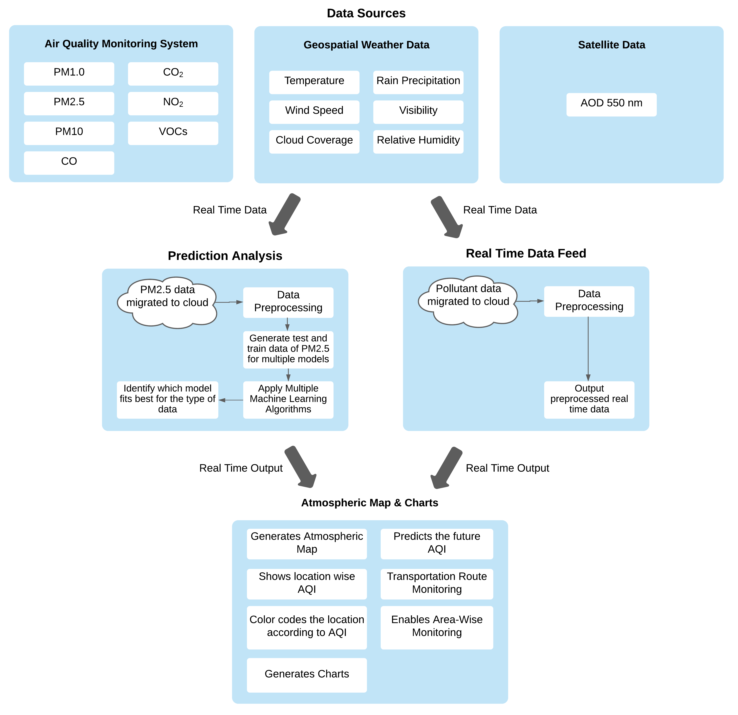
Software System Architecture of CAQ

Slide 12
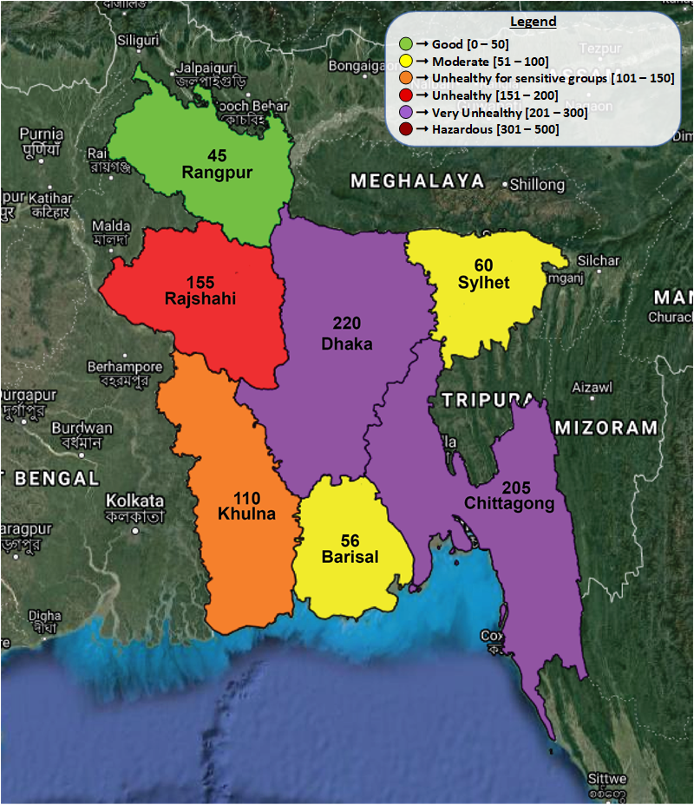
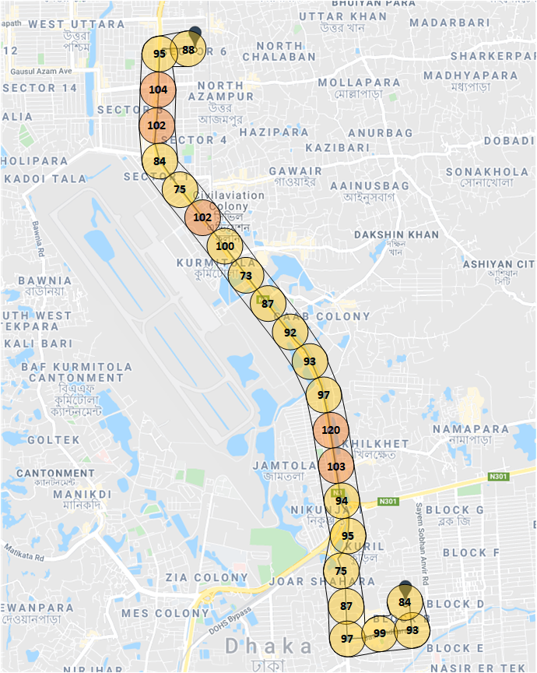
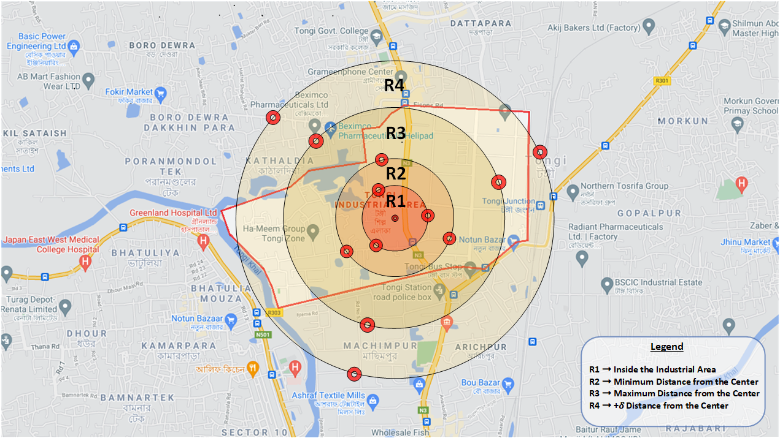
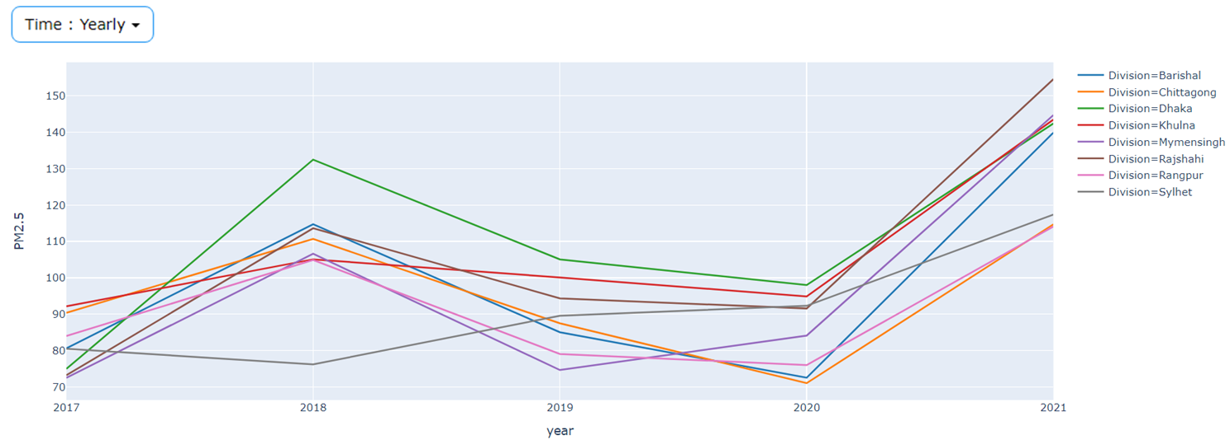
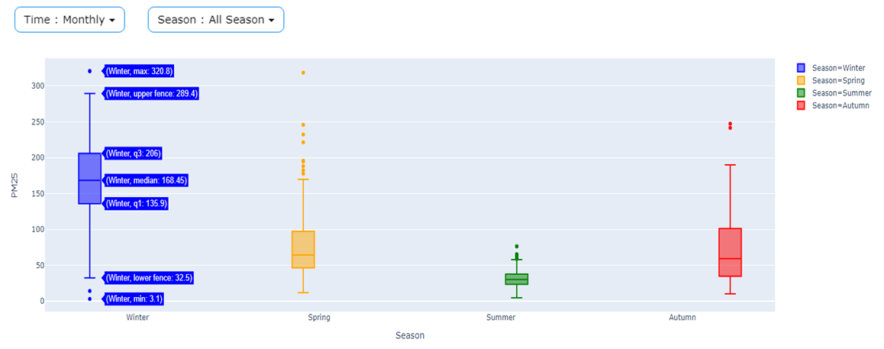
Maps and Charts Based User Interface
Atmospheric Map
Industrial Area Map
Transport Route Map
Division-Wise Time-Based UI
Box Plot UI

Slide 13
RefinAir
An inexpensive solution to an expensive problem.

Slide 14

An IoT based Device
RefinAir
Provides real-time data
An inexpensive device
Detects Temperature, Humidity, PM1.0, PM2.5, PM10, CO2
Monitors outdoor and indoor air quality.
High Quality sensors used

Slide 15
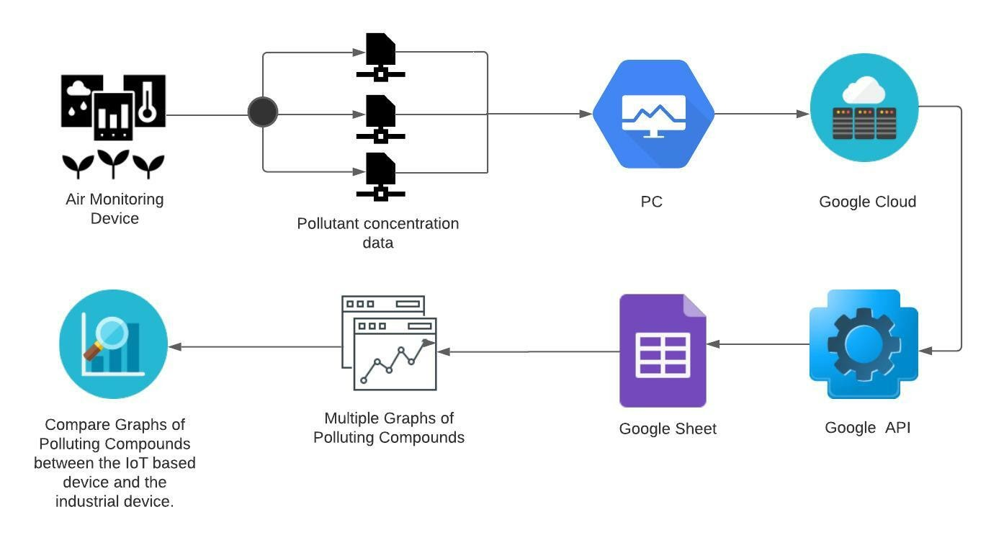
Rich Picture of RefinAir

Slide 16
Implementation of RefinAir
Sensors detects temperature, humidity, PM1.0, PM2.5, PM10, CO2 levels.
The data retrieved by the sensors are sent to the PC.
The data from the PC are sent to cloud.
Using Google API, the data is updated to the Google Sheet.
The Google Sheet generates multiple graphs.
The graphs are then compared with the purchased industrial-graded device, AirVisual Pro, to determine the IoT device’s compatibility.

Slide 17

Result Analysis
Day and night-time data were taken by both the devices from the same location.
The AirVisual Pro industrial-graded device was purchased to determine the device accuracy.
Graphs were compared and fruitful results were found.
The IoT based device has more cost efficiency than the industrial device.
The PM1.0, PM2.5, PM10 pollutants had a concentration difference of not more than 3 ug/m3.
Temperature, humidity and CO2 data had an accuracy difference of less than 1% for both the devices.

Slide 18

Advantages
Helps to monitor indoor and outdoor air quality.
Spreads awareness to the citizens and this approach might control the effects.
Cost effective
Provides real time data
Data accuracy
Compact device
Air pollutant data can be used as a resource for multiple purpose like generating Atmospheric Map.

Slide 19

Disadvantages
Power Supply
User Acceptance

Slide 20

Prediction of PM2.5 concentrations using Machine Learning
Reducing costs by utilizing resources

Slide 21
Prediction Model Goal
Predict PM2.5 from Aerosol Optical Depth (AOD) 550nm and geospatial weather data

Slide 22
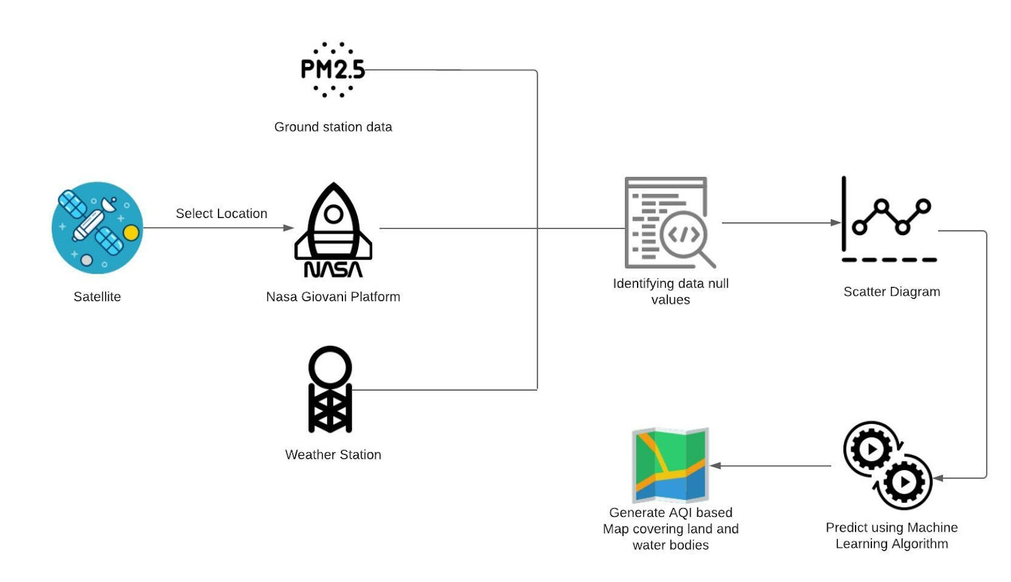
Rich Picture of Prediction of PM2.5 concentrations using Machine Learning

Slide 23
Dataset
Data | Source | Variables
Satellite Data | Nasa Earth Data (Giovanni) | Aerosol Optical Depth 550 nm
Air Quality Data | AirNow | PM 2.5
Weather Data | Visual Crossing | Temperature
 |  | Rain Precipitation
 |  | Wind Speed
 |  | Visibility
 |  | Cloud Coverage
 |  | Relative Humidity

Slide 24
Data Preprocessing
Data Cleaning
Data Integration
Data Transformation

Slide 25
Correlation Analysis
Ground Station PM2.5 data has high negative correlation with temperature, visibility, and cloud coverage.
It also has partial negative correlation with AOD 550nm, rain precipitation, wind speed, and relative humidity.
The dependent variable PM2.5 is correlated with the independent variables.

Slide 26
Methodology
Multiple Regression Linear (MLR) Model
Artificial Neural Network (ANN)
Random Forest
Gradient Boosting Regressor
Extreme Gradient Boosting (XGBoost)
CatBoost Regression

Slide 27


Result Analysis
Multiple Linear Regression (MLR)
$R^{2}$ Value for test dataset = 0.934
$R^{2}$ Value for train dataset = 0.784
RMSE for test dataset = 28.85
RMSE for train dataset = 32.2

Slide 28
Result Analysis
Artificial Neural Network (ANN)
RMSE = 31.112
Model Accuracy = 80.10%

Slide 29

Result Analysis
Random Forest
$R^{2}$ Value for test dataset = 0.79
$R^{2}$ Value for train dataset = 0.87
RMSE for test dataset = 31.71
RMSE for train dataset = 24.64
Model Accuracy = 79.40%

Slide 30

Result Analysis
Gradient Boosting Regressor
$R^{2}$ Value for test dataset = 0.80
$R^{2}$ Value for train dataset = 0.90
RMSE for test dataset = 30.94
RMSE for train dataset = 20.82
Model Accuracy = 80.32%

Slide 31

Result Analysis
Extreme Gradient Boosting (XGBoost)
$R^{2}$ Value for test dataset = 0.80
$R^{2}$ Value for train dataset = 0.96
RMSE for test dataset = 31.22
RMSE for train dataset = 13.34
Model Accuracy = 80.65%
AOD 550nm data shows the most future importance.

Slide 32

Result Analysis
CatBoost Regression
$R^{2}$ Value for test dataset = 0.82
$R^{2}$ Value for train dataset = 0.98
RMSE for test dataset = 29.46
RMSE for train dataset = 8.90
Model Accuracy = 82.17%

Slide 33

Result Discussion
Most effective model among all was Multiple Linear Regression (MLR) model.
MLR predicted PM2.5 using satellite derived and geospatial weather data with a $R^{2}$ value of 0.9344 for the testing dataset.
MLR predicted PM2.5 using satellite derived and geospatial weather data with a 𝑅^2 value of 0.9344 for the testing dataset.
CatBoost Regression model achieved the second best $R^{2}$ value of 0.82.
CatBoost Regression model achieved the second best 𝑅^2 value of 0.82.
Followed by the XGBoost model achieved a $R^{2}$ value of 0.80.
Followed by the XGBoost model achieved a 𝑅^2 value of 0.80.

Slide 34
Advantages
Cost effective
Accurate prediction model
Predict PM2.5 for remote areas and water routes.
No hassle of device implementation.
Predicted data can be used to generate Atmospheric Map

Slide 35
Disadvantages
Faulty data for short range radius distance of satellite data
Hard to extract satellite data
Predicted data may vary due to rough weather condition.

Slide 36

Future Work
Incorporate IoT based Data with the Satellite data and find another solution.
Take Country-wise, region-wise, transportation route wise data for both land and water bodies.
Introduce an Atmospheric Air Quality Monitoring Map Based Web Application.
Introduce a mobile application for better monitoring.
Analise seasonal affects for the prediction model

Slide 37

Thank you

